Slide 1


App registration for Modern SharePoint development: Unlock the mysteries of the Azure Key vault
By David Opdendries

Slide 2









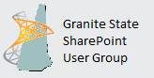

Thanks to our Sponsors

Slide 3

Who am I?

Slide 4




@sharepointdavid
www.spdavid.com
David.opdendries@affecto.com
https://github.com/spdavid/AppRegistrationDemo

Slide 5
Agenda
Modern Development : Where are we now?
Azure AD App Registration Introduction.
App only authentication
User / app authentication
The Key Vault

Slide 6
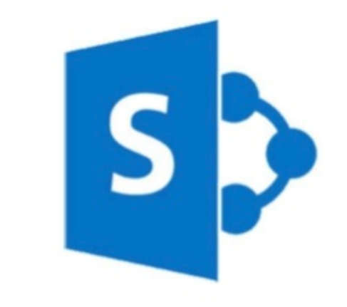
Modern Development Where are we now?

Slide 7
History
SharePoint Solutions Framework
Sandbox Solutions
Add-in Model / Azure
SharePoint Framework / Azure

Slide 8
Add-in Model
SharePoint Add-in : ASP.NET website
Remove Event Receivers / svc webservice
JavaScript Injection: Branding, Web Parts
Web Jobs
Storage Queues
ACS : Access Control Services

Slide 9
Modern Development Model
SPFx for Web parts and extensions
Web jobs
Azure Functions
Web hooks for events
Storage Queues
Azure AD – App registration

Slide 10
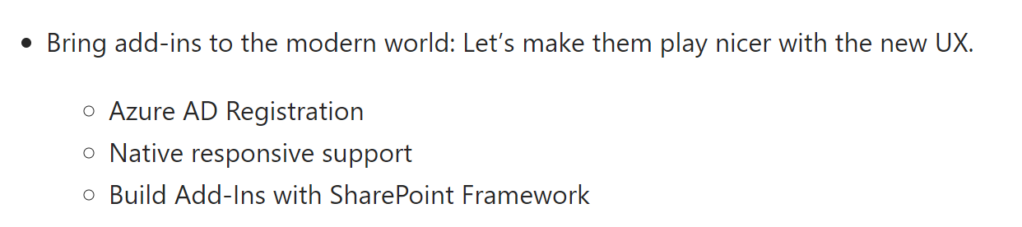
RoadMap
https://docs.microsoft.com/en-us/sharepoint/dev/spfx/roadmap

Slide 11

Azure AD App Registration Introduction.

Slide 12
Appregnew.aspx vs Azure AD App Registration
Appregnew.aspx / appinv.aspx
Azure AD app registration
Can fine tune permissions
List permissions
Web permissions
Secret expires after 1 year
Secrets administrated via PowerShell
Uses ACS in the background
Contains UI for administration
Several secrets can be used
Easier Administration
Once Client ID for both SharePoint and the Graph
Can set expiry date of secrets

Slide 13
Types of Authentication
User Only : SPFx, code running on a SharePoint site
App Only: Applications Permissions only
User / App : Both the user and the App need access to the resource

Slide 14
How to register an application
Through the Azure Portal under Azure Active Directory -> App Registrations
Microsoft app registration portal : https://apps.dev.microsoft.com/
https://docs.microsoft.com/en-us/azure/active-directory/develop/active-directory-appmodel-v2-overview

Slide 15
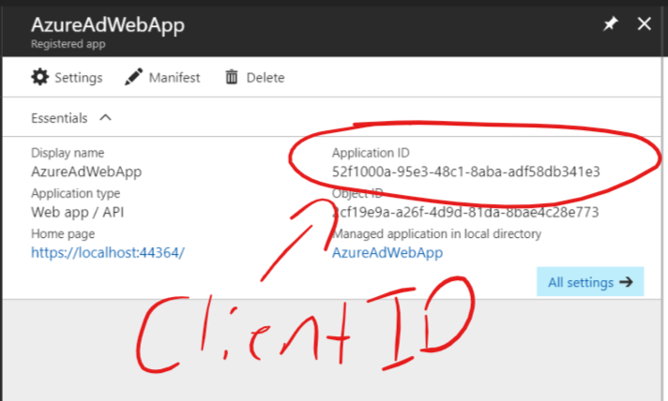
Application ID = Client ID

Slide 16
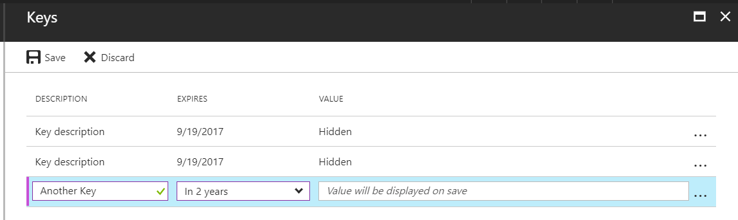
Keys = ClientSecrets

Slide 17
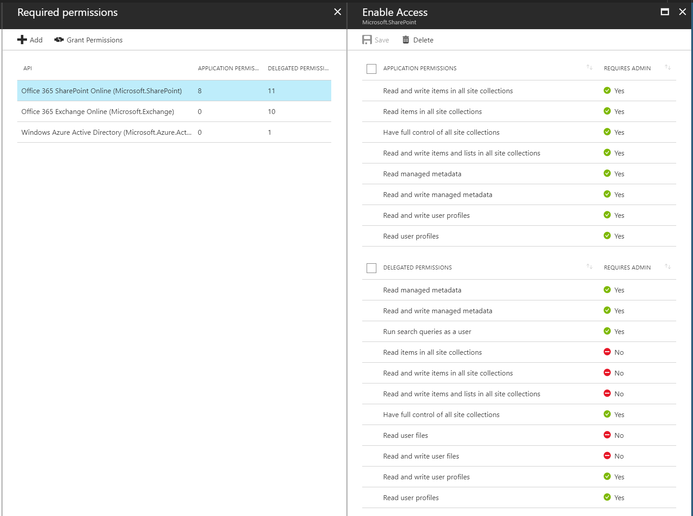
Give your application permissions

Slide 18
Demo

Slide 19
App only authentication

Slide 20
Getting the app only context
Nuget Package SharePointPnPCoreOnline
AuthenticationManager
Certificate
ClientId
ClientSecret

Slide 21
Generating the Certificate
#Create certificate and export it
$newCert = New-SelfSignedCertificate -KeySpec Signature -certstorelocation cert:\CurrentUser\my -dnsname $keyName -NotAfter ((Get-Date).AddYears(10))
$pwd = ConvertTo-SecureString -String "p@ssw0rd" -Force -AsPlainText # password is not important it is not stored later in azure or used
Export-PfxCertificate -cert ("cert:\CurrentUser\my\" + $newCert.Thumbprint) -FilePath ("c:\" + $keyName + ".pfx") -Password $pwd

Slide 22
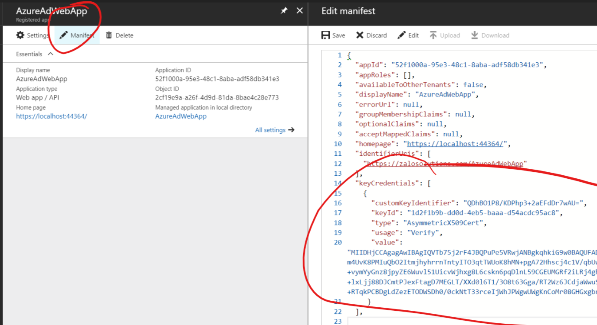
Update the manifest

Slide 23
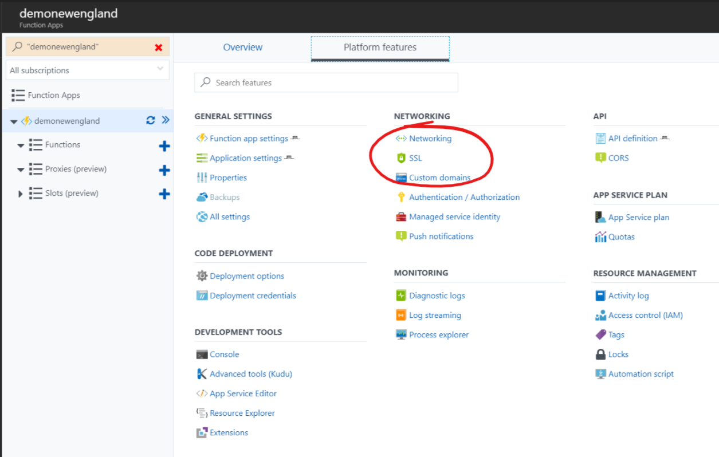
Upload Certificate
WEBSITE_LOAD_CERTIFICATES

Slide 24
App Settings
WEBSITE_LOAD_CERTIFICATES= Thumbprint or *

Slide 25
Demo

Slide 26
App/User authentication

Slide 27
Getting the User/App Context
PNP AuthenticationManager
GetAzureADWebApplicationAuthenticatedContext
Web Application Connected to Tenant
Users AccessToken

Slide 28
Demo

Slide 29
Accessing the Key Vault

Slide 30
What is the Key Vault?
Safeguards cryptographic keys and secrets used by cloud applications and services. By using Key Vault, you can encrypt keys and secrets (such as authentication keys, storage account keys, data encryption keys, .PFX files, and passwords)

Slide 31
How to access the keyvault?
Registered App
App will need Permissions to the key vault
Secret Url

Slide 32
NuGet Packages
Microsoft.IdentityModel.Clients.ActiveDirectory
Microsoft.Extensions.Configuration.AzureKeyVault

Slide 33
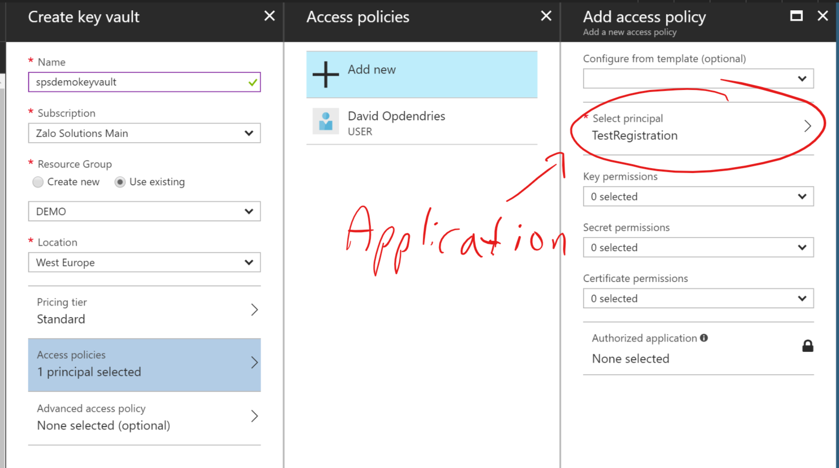
Give your App permissions on creation

Slide 34
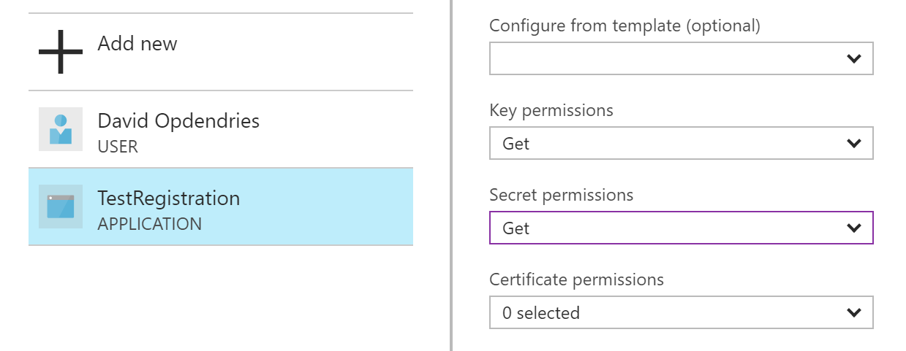
Key Permissions

Slide 35
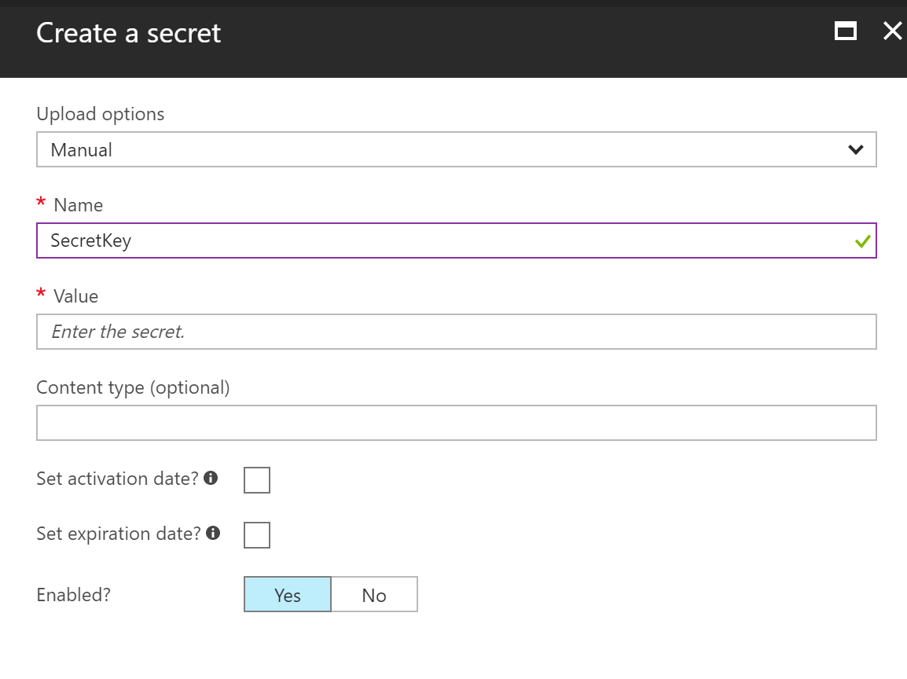
Creating a secret

Slide 36
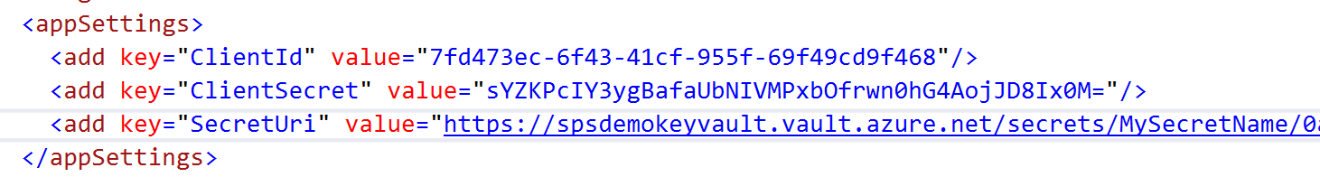
Application Settings

Slide 37
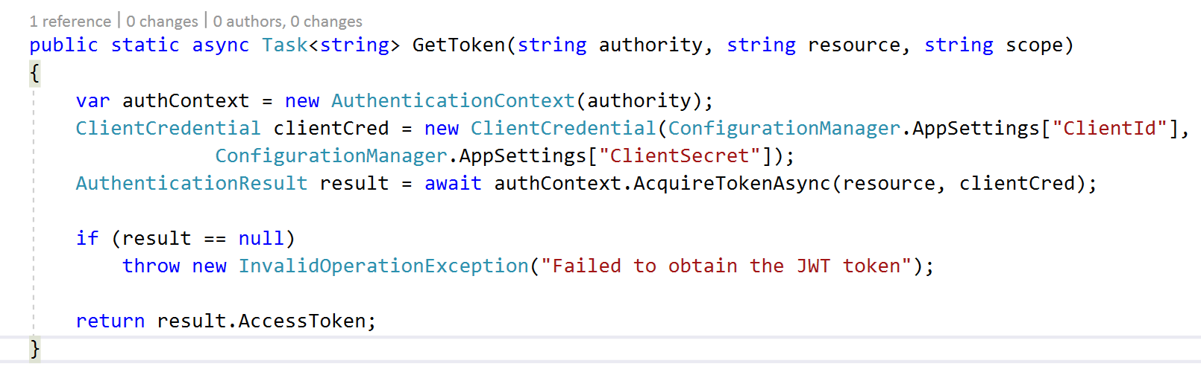
GetToken Method

Slide 38
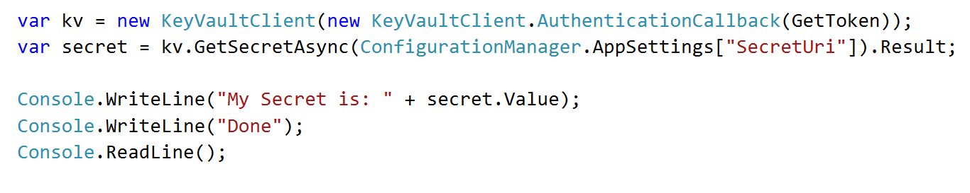
Getting the secret value

Slide 39
Demo

Slide 40
Thanks to our Sponsors

